Slide 1
Using ABM to Simulate a Dance Party
Selen Berkman

Slide 2
Introduction
Agent-based modeling to model human interaction
Patterns of human behavior in crowds
Crowd simulation has been used to model evacuations as well as provide realistic behaviors for sociological study or video game simulation
I was interested in looking at patterns of people’s behavior at a party with dancing
I wanted to examine how the presence of different personality types impacted the dynamics of the party

Slide 3
Literature Review
Agent-Based Human Behavior Modeling for Crowd Simulation (2008)
Creating Crowd Variation with the Ocean Personality Model (2014)
Agent-based Crowd Simulation Considering Emotion Contagion for Emergency Evacuation Problem (2015)
Integrating Personality and Emotion for Human Crowd Simulation (2015)

Slide 4
Agent-Based Human Behavior Modeling for Crowd Simulation (2008)
Linbo Luo, Suiping Zhou, Wentong Cai, Malcolm Yoke Hean Low, Feng Tian, Yongwei Wang, Xian Xiao, Dan Chen
Crowd behavior module, individual behavior module, and physical behavior module
Physical behavior module feeds sensory inputs into individual behavior module and crowd behavior module
Crowd behavior module captures social relationships between agents

Slide 5
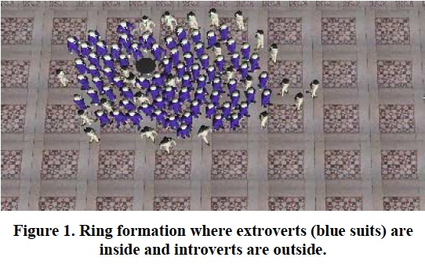
Creating Crowd Variation with the Ocean Personality Model (2014)
Funda Durupinar, Jan Allbeck, Nuria Pelechano, Norman Badler
OCEAN Personality Model (openness, conscientiousness, extraversion, agreeableness, and neuroticism)
Integrates a crowd simulation system, HiDAC, with the OCEAN personality model
Enables simulation of heterogeneous crowds

Slide 6
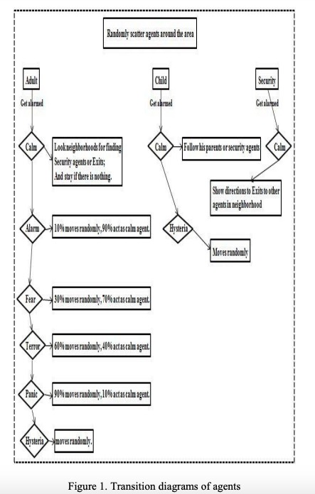
Agent-based Crowd Simulation Considering Emotion Contagion for Emergency Evacuation Problem (2015)
Hamed Faroqi, Mohammad-Saadi Mesgari
Use NetLogo
Agents are child, adult, or security
Each type of agent has different emotion capabilities
Each agent reacts in a different way based off of their emotions

Slide 7
Integrating Personality and Emotion for Human Crowd Simulation (2015)
Jacob Sinclair and Carrie Siu Man Lui
Builds upon previous work that looked at personality and emotion separately
Each agent has both personality and emotions, and personality influences emotions

Slide 8
Question of Interest
In my model of a crowd at a party, I wanted to included personality traits as well as emotion
To keep the model simple, I chose to focus on one personality trait and one emotion
I focused on extroversion as the personality trait because extroversion plays a very large role in how a person will feel about and act at a party
I chose to look at happiness/lack of happiness as people tend to go to parties to feel happy

Slide 9
Modeling Approach
Agent-based modeling
Each agent is a person attending a party
Each agent has a personality type of introvert, ambivert, or extrovert
Object-oriented programming approach
Each agent is a python object
The attributes of the agents are instance variables
Implemented using the mesa package in python

Slide 10
Modeling Approached Continued
Agent attributes based on personality type
Range of total number of neighbors they are comfortable with
Comfort range for the number of dancing neighbors
Base probability of dancing
Each agent’s probability of dancing increases as more of their neighbors dance
Agents who choose to dance commit to dancing for three steps of the model
If an agent isn’t surrounded by an overall number of neighbors and number of dancing neighbors in their comfort range, they move

Slide 11
Demonstration

Slide 12
Conclusion
What I learned
ABMs can get complicated very quickly as you add more attributes to the agents
Use existing tools, such as mesa, rather than reinventing the wheel
Hardest part of the project: making sure that as I added more parts to the code, that the code continued to work properly
Easiest part of the project: using mesa to visualize the model
What I would like to add in the future: better tuning of the attributes to match real-life personalities and human behaviors

Slide 13
Works Cited
http://gamma.cs.unc.edu/LARGE/papers/agent-based_behavior.pdf
https://www.researchgate.net/publication/237502245_Creating_Crowd_Variation_with_the_OCEAN_Personality_Model_Short_Paper
https://d-nb.info/1143759702/34
https://researchonline.jcu.edu.au/43137/1/43137%20Lui%20and%20Sinclair%202015.pdf
https://towardsdatascience.com/introduction-to-mesa-agent-based-modeling-in-python-bcb0596e1c9a

